Slide 1
CSE 455 Final Project
Bird identification
Gan Gao
March 18th, 2021
gangao@uw.edu

Slide 2
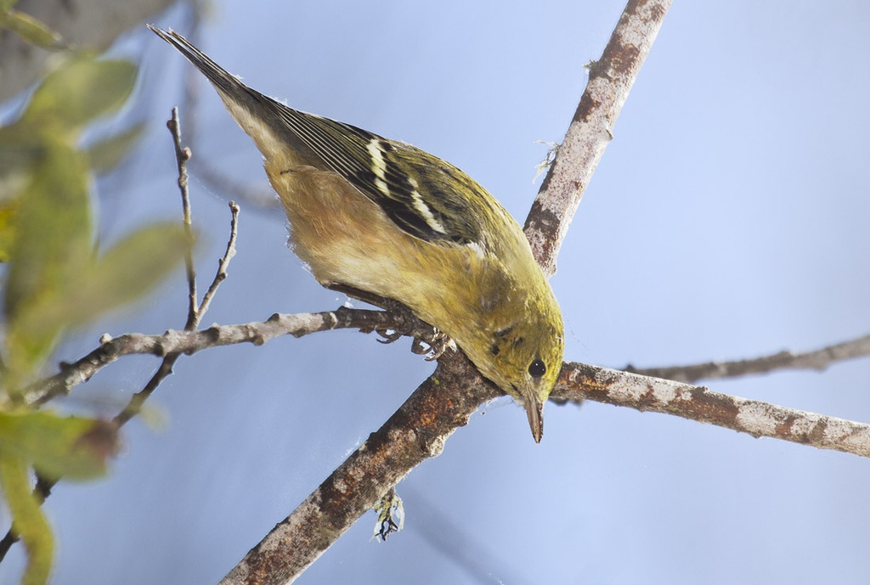
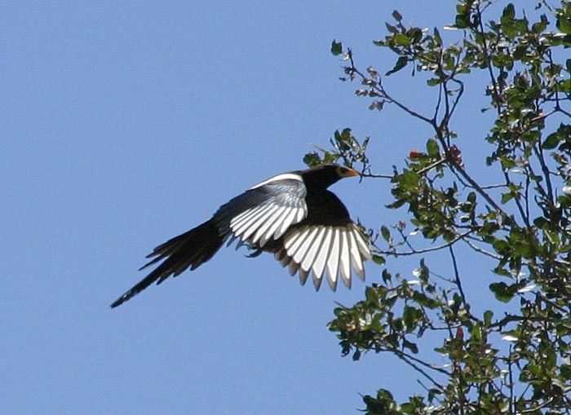
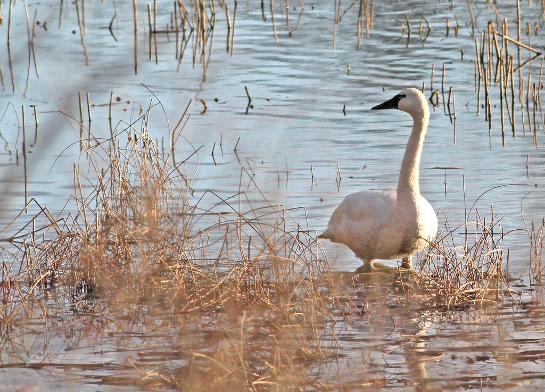
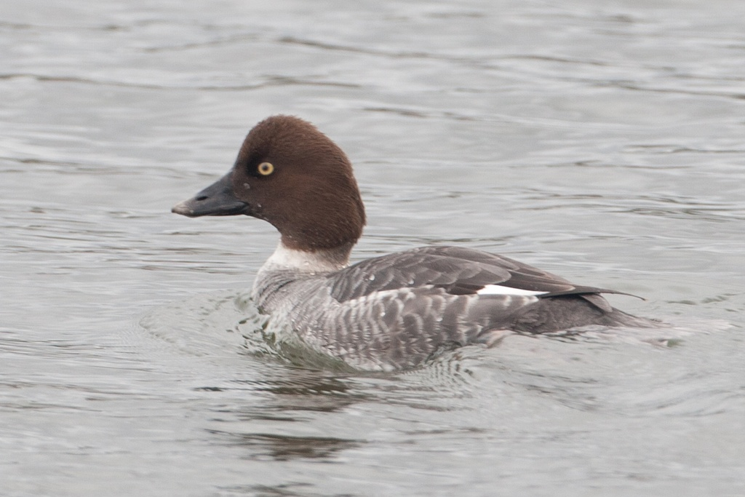
Background
Purpose: classification of 555 kinds of birds from an image.
Dataset: 38562 for training and 10000 for testing.
Yellow-billed Magpie
Bay-breasted Warbler
Tundra Swan
Common Goldeneye
1
gangao@uw.edu

Slide 3
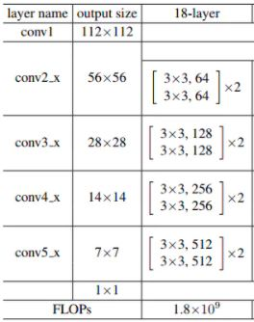
Resnet 18 tuning
Anneal learning
Learning rate 0.1 for 5 epochs, 0.01 for 10 epochs, 0.001 for 5 epochs.
Data augmentation
Random rotation -> Resizing -> Random cropping -> Random horizontal flipping
Batch size
Increase the batch size to 256, which ensures convergence and decrease oscillation.
Resnet 18 model
Image size
Crop 256*256 patches as input, satisfied by GPU memory.
2
X
gangao@uw.edu

Slide 4
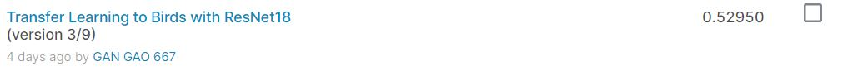
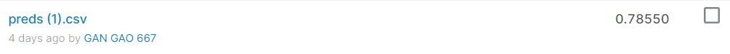
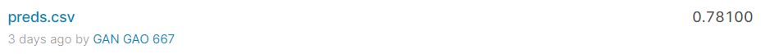
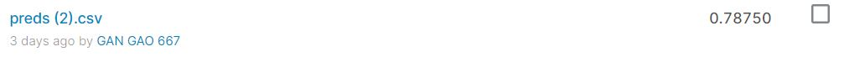
Resnet 18 tuning
Baseline
After tuning
Less epochs - training from checkpoints 13 and train 18 epochs in total.
More epochs - training from checkpoints 15 and train 23 epochs in total.
20 epochs should be enough for converging.
3
X
gangao@uw.edu

Slide 5
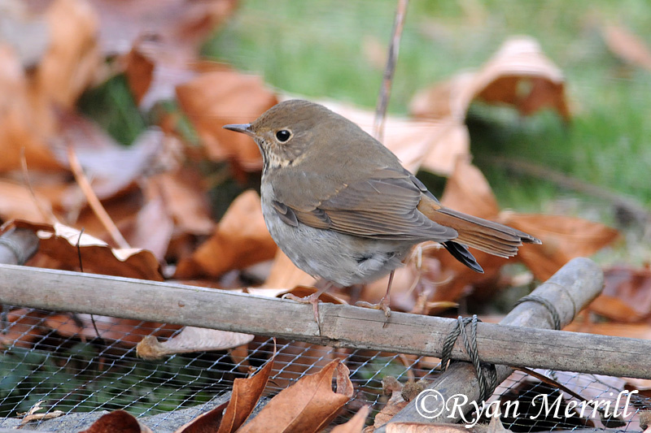
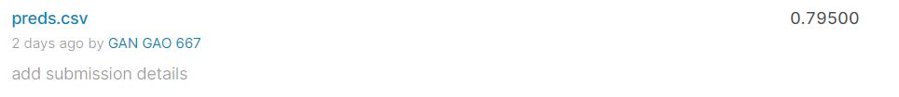
Multi-view testing
Random cropping testing image and predicting by voting
Best score!
4
X
gangao@uw.edu

Slide 6
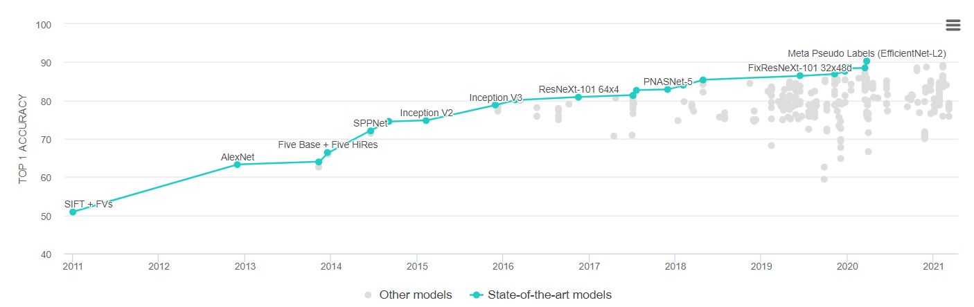
Resnext
Tunning
Learning rate 0.15 for 10 epochs, 0. 1 for 15 epochs, 0. 01 for 10 epochs, 0.001 for 5 epochs and 0.0001 for 3 epochs.
Take 128*128 cropping of images and 64 as the batch size.
5
X
gangao@uw.edu

Slide 7
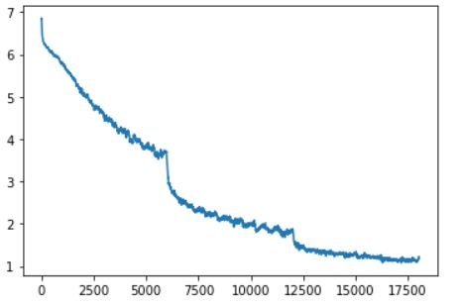
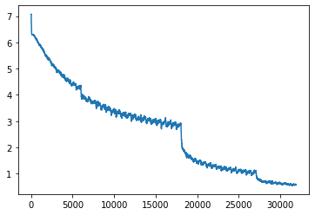

Resnext convergence
6
X
gangao@uw.edu

Slide 8
Thank you!
Gan Gao

